Slide 1

Local Linearity! Calculus 1: intro to derivatives
David Gonzalez Sua

Slide 2
Learning Targets
Students can identify whether a function is locally linear at a given point by zooming in
Students can estimate the slope of a function at a point graphically
Students can connect the idea of local linearity to the formal definition of the derivative

Slide 3
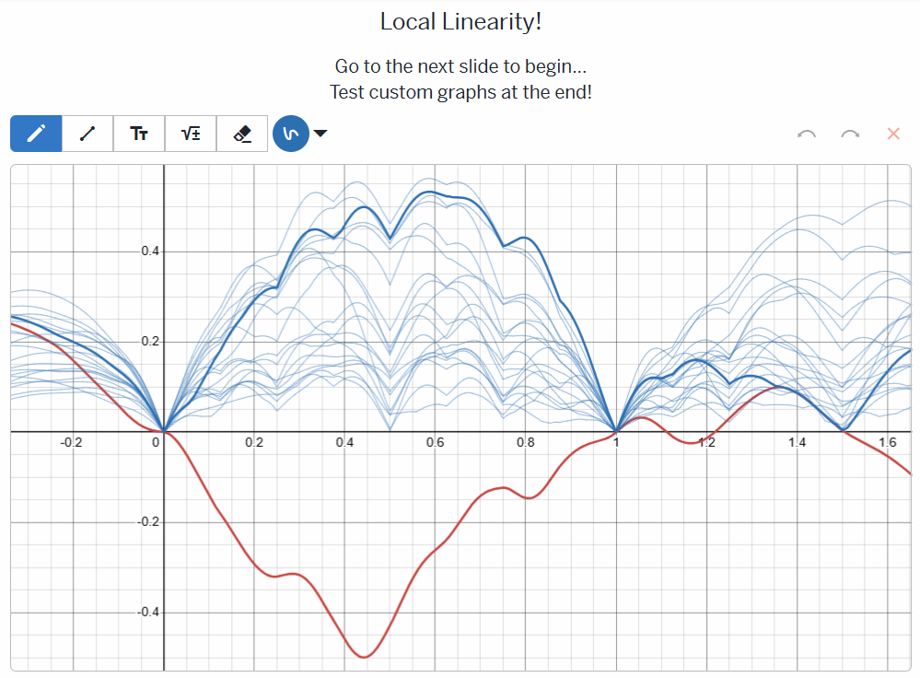
The main idea:
What happens when you zoom in on a smooth curve?
Teacher Link:
https://classroom.amplify.com/activity/69dadb530bf728ee5efa0703?utm_campaign=share&utm_content=activity
Student.amplify.com/join
JE FR GU
https://student.amplify.com/join/JEFRGU

Slide 4
Activity “SOLUTION KEY”:
Students try it first.
Slide 1: Cool graph!
Slide 2: Students should notice that there is local linearity at every point. Noticing that it approaches the tangent line is a plus!
Slide 3: Students should notice that the slope of the line is never negative, and connect that to the shape of e^x
Slide 4: Students should notice that it is impossible to get a straight line at x=0 for |x| regardless of zoom level.
Slide 5: Students can test further if they like.
Then a teacher should go through the slides with the tangent line on to show that the slopes approach it. Ideally, this lesson would be directly followed by a lesson on derivatives.

Slide 5
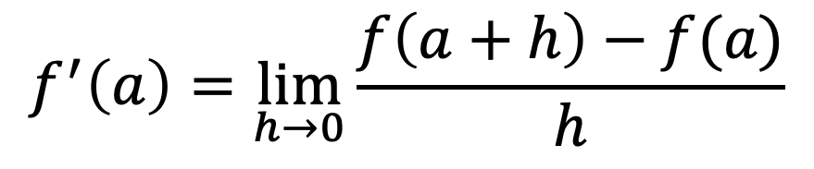
Connections to math-534
If you zoom in on the graph of a function with equal zoom factors in both directions, the graph eventually looks like a line. This property is called Local Linearity. The slope of this line is the number called the derivative. If the graph never appears linear, then no derivative exists at that point.
Local Linearity is the graphical manifestation of differentiability!
Limit definition of a derivative
$$f^{′}\left(a\right)=\lim_{h→0}{\frac{f\left(a+h\right)−f(a)}{h}}$$

